Slide 1

GoShala Care:
Early Detection and Management of Cow Diseases
Sinchana S & Manisha K
Final Year CSE
Alva's Institute of Engineering and Technology, Moodbidri

Slide 2
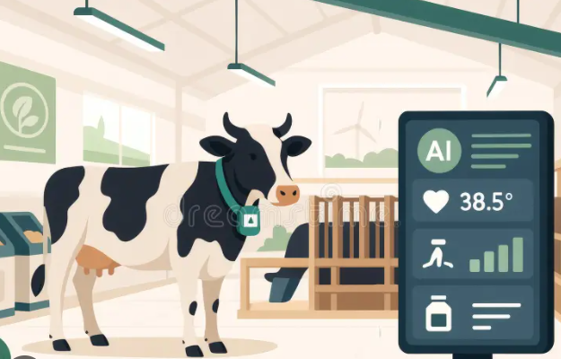
Problem Statement
Early identification of cattle health problems is difficult through manual observation alone.
Farmers may not have continuous access to veterinarians, especially when immediate professional assistance is unavailable.
Existing smart monitoring solutions often depend on IoT sensors, wearable devices or specialised equipment, increasing complexity and cost.
Health information such as temperature, feed intake, water intake and milk production is often not systematically recorded and monitored over time.
Changes in a cow's normal health pattern may therefore be missed until the condition becomes more noticeable.
There is a need for a simple, accessible and intelligent system that helps farmers monitor cattle health, identify potential risks early and connect high-risk cases with veterinarians.

Slide 3
Proposed Solution
GOSHALA CARE
Develop GoShala Care, a web-based cattle health monitoring and early-risk detection system.
Allow farmers to record temperature, feed intake, water intake, milk yield and observed symptoms for each cow.
Maintain historical health records to monitor changes and trends over time. Combine rule-based analysis and machine learning to assess the health condition of each cow.
Classify cattle into Low, Moderate or High risk based on the available health information.
Provide early alerts for Moderate- and High-risk cases. Enable veterinarians to review flagged cases and provide recommendations.
Provide separate dashboards for Farmers, Veterinarians and Administrators. Reduce dependency on specialised hardware while providing a practical and accessible cattle-health management platform.

Slide 4
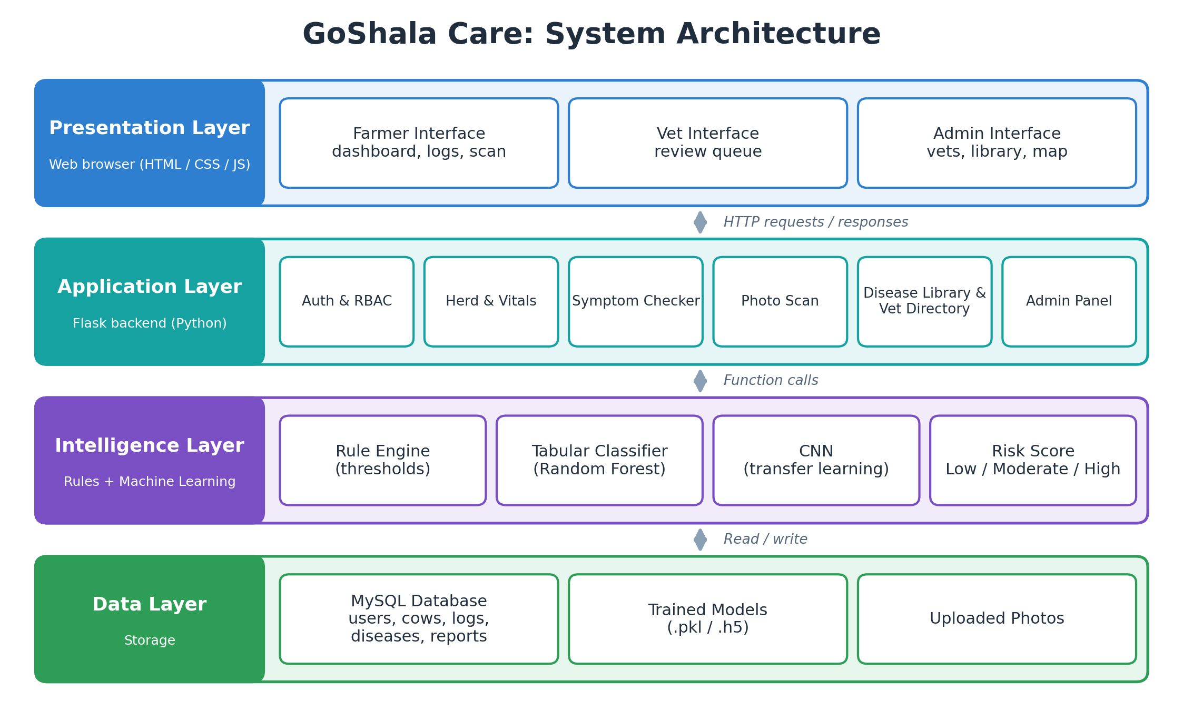
System Architecture

Slide 5
Key Features
🐄 Cow Health Monitoring – Maintain individual health records for each cow.
📋 Daily Health Logging – Record temperature, feed intake, water intake, milk yield and symptoms.
🤖 AI-Based Risk Assessment – Analyse health data using machine learning.
⚠ Risk Classification – Categorise cows into Low, Moderate or High Risk.
📈 Health Trend Analysis – Track changes in health parameters over time.
🚨 Early Alerts – Highlight cows requiring closer attention.
📷 Photo-Based Screening – Support image-based identification of selected visible conditions.
👨‍ Veterinarian Review – Allow vets to review Moderate/High-risk cases and provide advice.
📚 Disease & Symptom Library – Provide relevant disease and symptom information.
👥 Role-Based Dashboards – Separate interfaces for Farmer, Veterinarian and Admin.
🗺 Veterinarian Directory – Display available veterinarian information and locations.
🔐 Secure Access – Role-based authentication and controlled access to system functions.

Slide 6
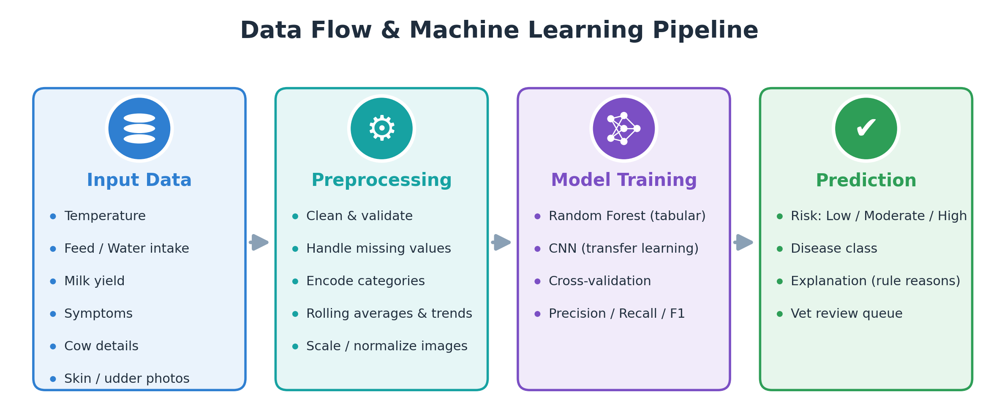
Data Science Pipeline
Data cleaning: missing values, duplicate images, invalid readings removed
Feature engineering: rolling averages and trend features (e.g. milk drop %)
Tabular model (Random Forest) for vitals + symptoms
Image model (MobileNetV2 transfer learning) for photo scans
Evaluated with precision, recall and F1, not accuracy alone, due to class imbalance

Slide 7
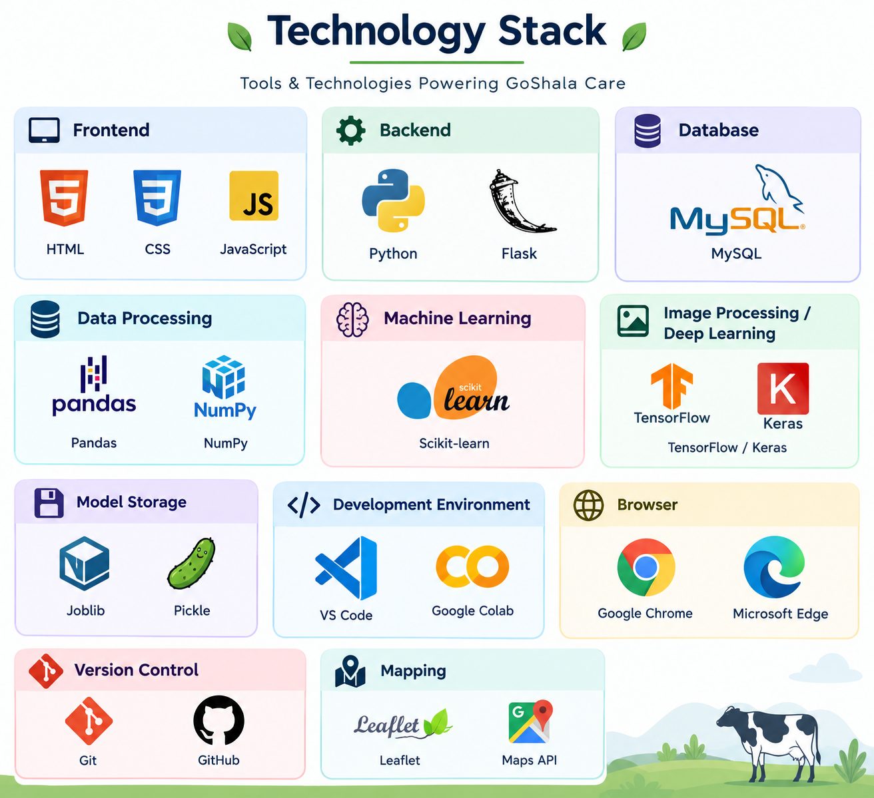
Technology Stack
Frontend: HTML, CSS, JavaScript
Backend: Python, Flask
Database: MySQL
Data Processing: Pandas, NumPy
Machine Learning: Scikit-learn
Image Processing / Deep Learning: TensorFlow / Keras
Model Storage: Joblib / Pickle
Development Environment: VS Code / Google Colab
Browser: Google Chrome / Microsoft Edge
Version Control: Git & GitHub

Slide 8
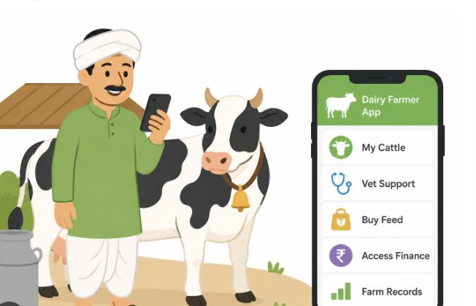
Roles & Dashboards
Farmer: manages cows, logs daily vitals, runs the symptom checker and photo scan, sees alerts and milk trends
Vet: reviews the queue of flagged cases (sorted by urgency) and responds with advice
Admin: manages vet and user accounts, the vet directory and map, and the disease reference library
Each role has its own dashboard, with access enforced on the backend, not just hidden in the UI

Slide 9
Conclusion & Future Scope
Conclusion
Developed a web-based system for early cattle disease detection and health monitoring.
Enables farmers to record cow health parameters, symptoms and other observations.
Combines rule-based assessment with machine learning for risk classification.
Provides Low, Moderate and High risk levels for easier health monitoring.
Connects high-risk cases with veterinarians for further review and guidance.
Provides separate interfaces and functions for Farmers, Veterinarians and Administrators.
Reduces dependency on dedicated IoT hardware for basic health monitoring. Demonstrates the use of AI and web technologies for practical cattle-health management.

Slide 10
Conclusion & Future Scope
Future Scope
Integrate IoT sensors for automatic real-time health monitoring.
Add Kannada and other regional-language support.
Introduce voice-based interaction for easier farmer access.
Expand image-based detection to cover more cattle diseases.
Implement disease outbreak mapping using geographical data.
Add an AI chatbot for basic cattle-health guidance.
Improve personalised monitoring using long-term individual cow history.
Develop a dedicated mobile application for farmers.

Slide 11
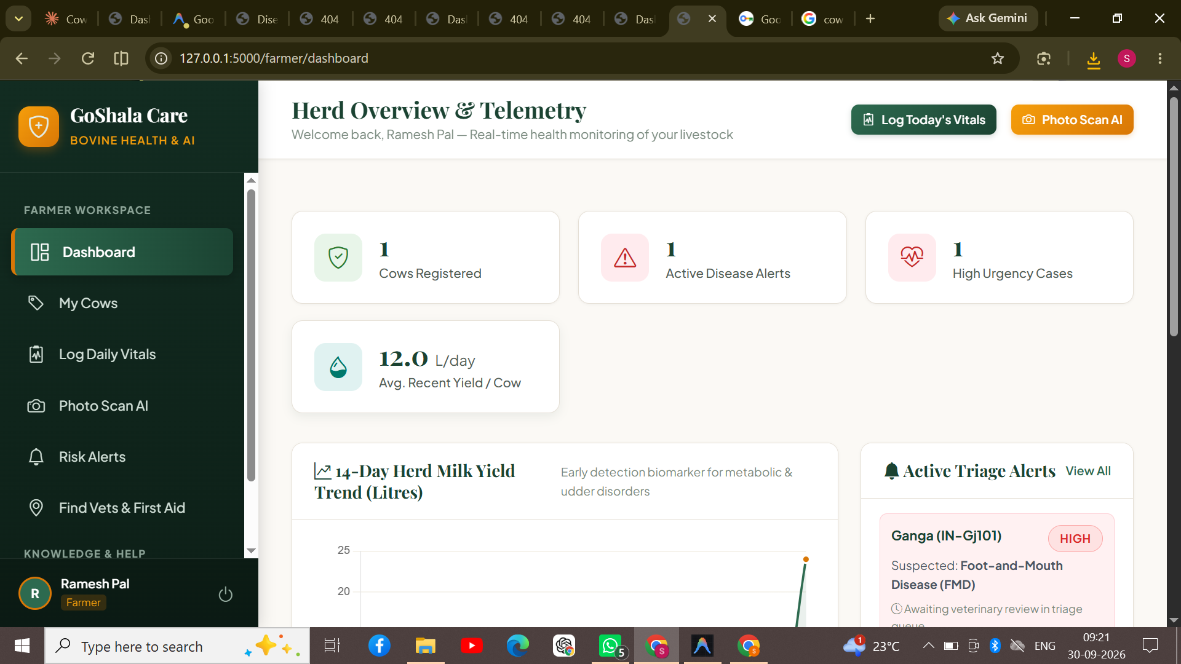
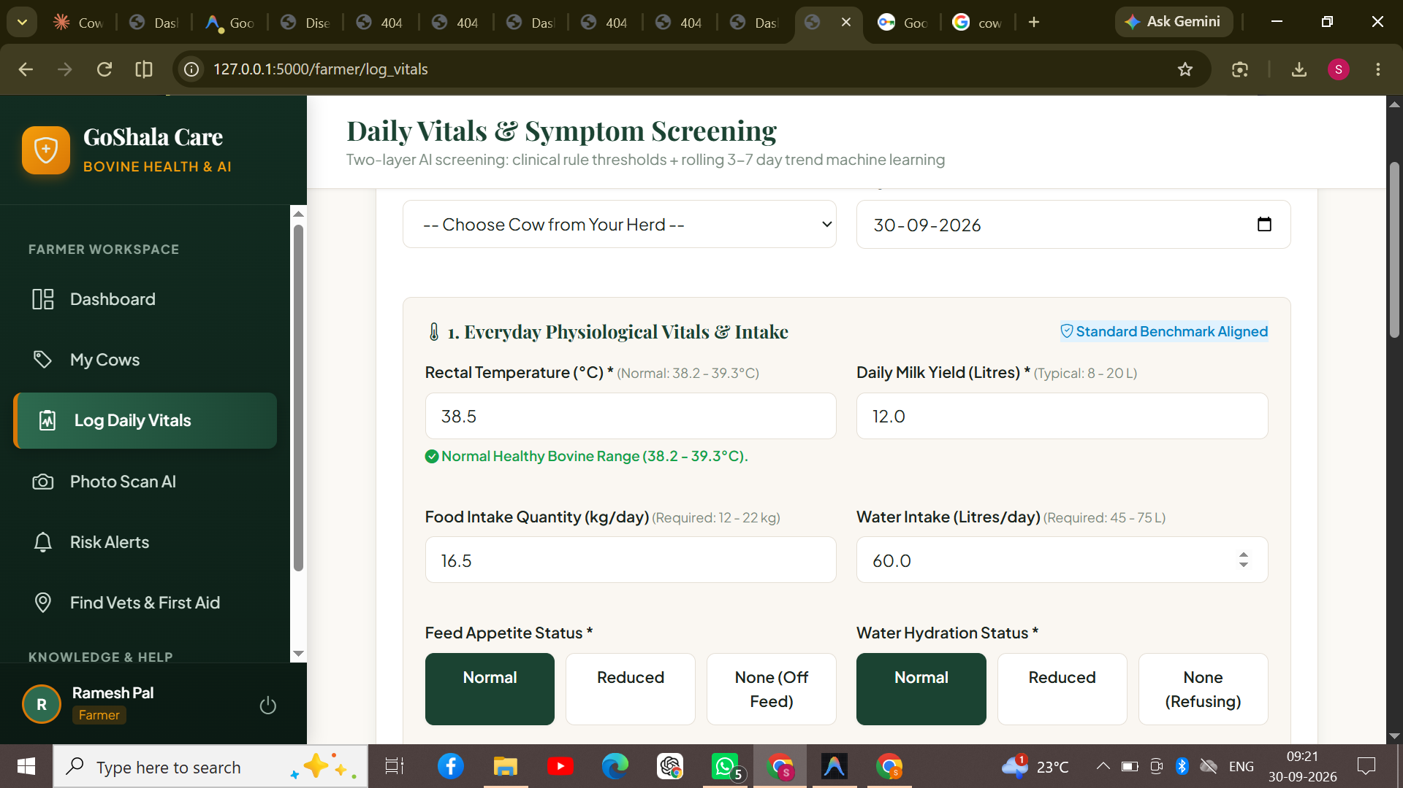
Results
Farmer dashboard: herd overview and alerts
Daily vitals and symptom screening form

Slide 12
Thank You
GoShala Care — Early Detection and Management of Cow Diseases

